Slide 1
CYB 307: Information Security Engineering
Ageebee Silas Faki PhD
08066238988
faki.silas@binghamuni.edu.ng

Slide 2
Basic Policies of Information Security
An Information Security Policy (ISP) is a set of rules that guide individuals when using IT assets.
Companies can create information security policies to ensure that employees and other users follow security protocols and procedures.
Security policies are intended to ensure that only authorized users can access sensitive systems and information.
Creating an effective security policy and taking steps to ensure compliance is an important step towards preventing and mitigating security threats.

Slide 3
To make an organizational policy truly effective when it is updated frequently based:
on company changes,
new threats,
conclusions drawn from previous breaches,
and changes to security systems and tools.

Slide 4
Administrative Network Security
Compliance, policies, and governance are integral to an information security program for any organization.
An organization needs to comply with certain regulatory standards to run its businesses.
At the same time, it must also have strong security policies and governance in order to fulfill regulatory standards.
All the process involve as mention in this slide is termed Administrative Security

Slide 5
Regulatory Frameworks Compliance
Regulatory framework compliance is a set of guidelines and best practices established in order for organizations to follow and, thus, meet their regulatory needs, enhance processes, improve protection, and accomplish any other objectives based on the industry and data types maintained.
Complying with regulatory frameworks is a collaborative effort between governments and private bodies to encourage voluntary/mandatory improvements to cybersecurity.
Regulatory compliance prevents organizations from incurring large fines or being victim to data breaches

Slide 6
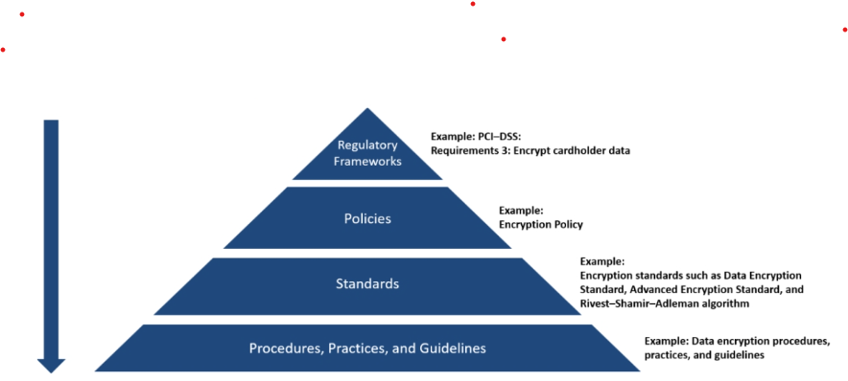
To ensure cybersecurity, organizations must implement the following standards to meet regulatory framework compliance:

Slide 7
Regulatory Frameworks: Under a framework, an organization must document its policies, standards as well as procedures, practices, and guidelines. Each of these aspects have different purposes; hence, they cannot be combined into one document.
Policies
Policies are high-level statements dealing with the administrative network security of an organization. These are leveraged by an organization’s senior management. Organizations require at least one policy in place. A policy is viewed as a business mandate and has a top-down management.
Some examples of policy include email and encryption policies.
They generally outline the
Security roles and responsibilities,
Scope of information to be secured,
Description of the required controls for securing information,
References to standards and guidelines that support the policies.

Slide 8
Standard
Standards comprise specific low-level mandatory controls or controls related to the implementation of a specific technology useful for enforcing and supporting policies and ensuring consistent businesses security.
As noted earlier, this includes password policy such as password standards for password complexity, or encryption policy, which include standards such as data encryption standard (DES), advanced encryption standard (AES), and Rivest–Shamir–Adleman algorithms

Slide 9
Procedures, Practices, and Guidelines
Procedures or standard operating procedures (SOP) comprise step-wise instructions useful for implementing the controls that are defined by multiple policies, standards, and guidelines such as a procedure for secure Windows installation or data encryption procedure, practices, and guidelines.
Guidelines comprise recommendations, but non-mandatory controls, as well as general statements, administrative instructions, or best practices useful for supporting standards or acting as a reference when no are standards in place. Guidelines and best practices are interchangeable.
These changes are environment-dependent and must be reviewed more often than standards and policies. For example, a standard may state that a password should be eight characters or more, while a supporting guideline may state that it is also a best practice to follow password expiration and data encryption guidelines

Slide 10
Why Organizations Need Compliance
Information security compliance should be a requirement than a choice for organizations, since the money, time, and efforts invested in the compliance is worth more than the cost of risks. The advantages that regulatory framework compliance brings for an organization include:
Improved Security: IT security regulations and standards improve the overall security of an organization by meeting baseline regulatory requirements. These baseline requirements ensure consistent data security.
Minimized Losses: Improved security can prevent security breaches, which otherwise can lead to losses, repair costs, legal fees, or hefty fines.
Maintenance of Trust: Data breaches cause companies to lose their reputation and trust from customers. Compliances makes customers trust an organization with the belief that their information is safe.
Increased Control: An organization’s security increases with increased controls such as preventing employees from committing mistakes, implementing strong credential systems and encryption systems, or monitoring outside threats.

Slide 11
End

